Slide 1

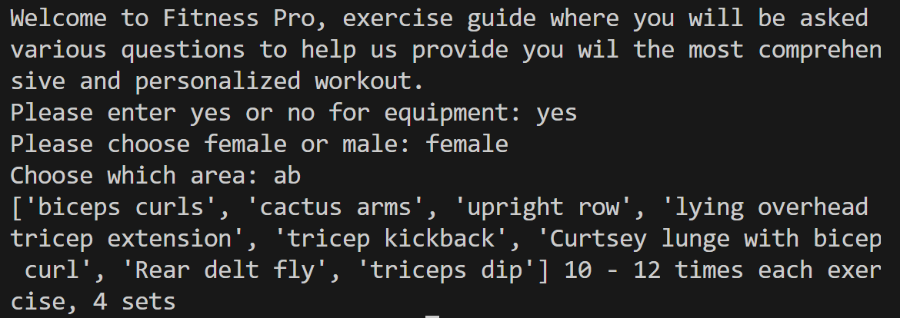
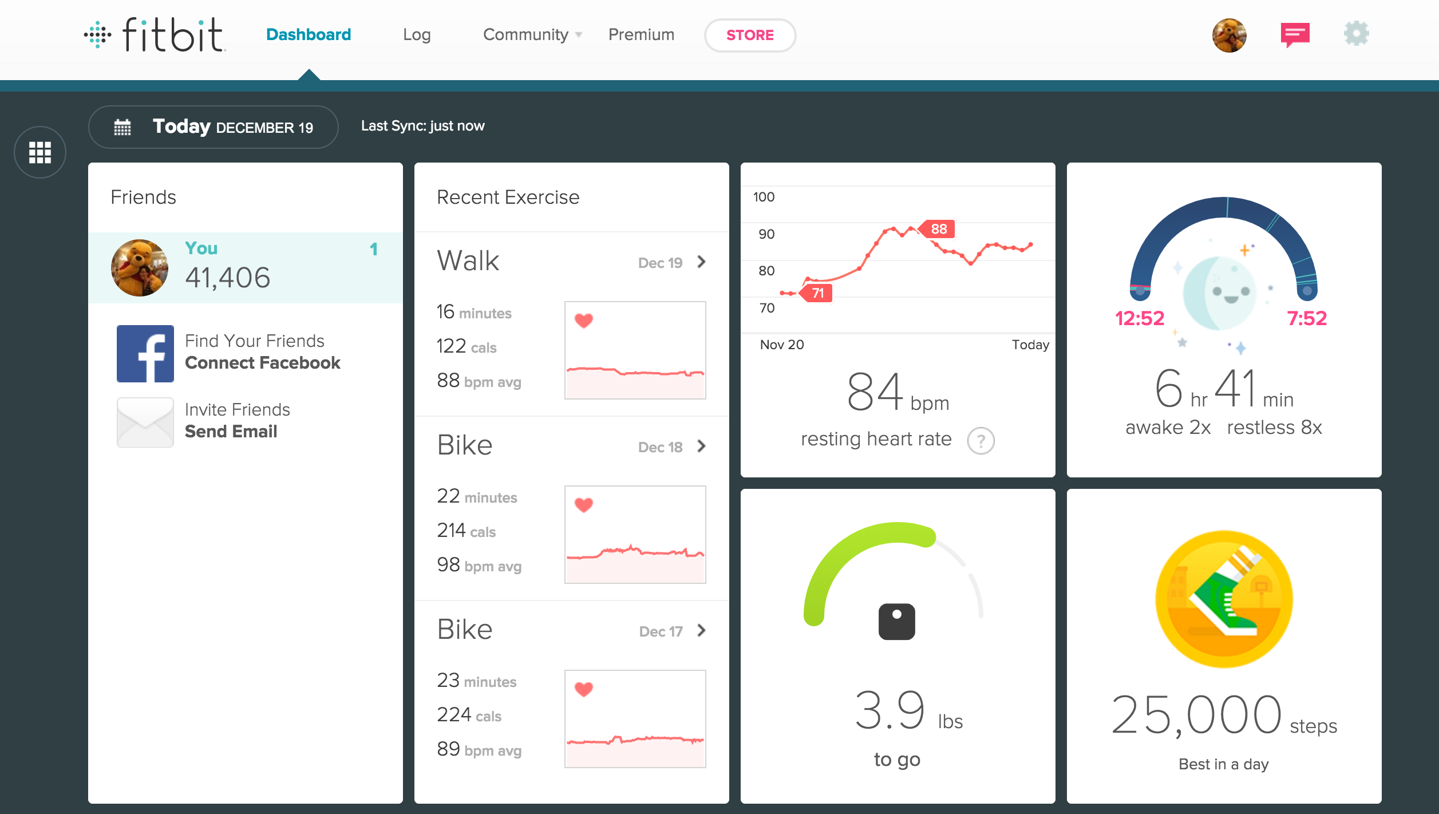
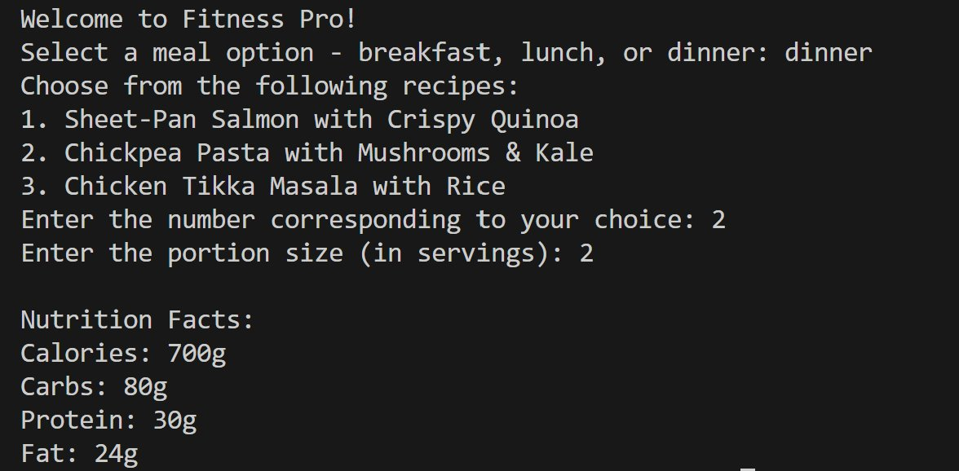
Fitness Pro
Coded by Olivia Taylor and Soha Nathani
https://github.com/ksu-is/FitnessPro
This fitness app creates a personalized fitness plan that allows you to engage in all kinds of workouts and nutrient regimens.

